Slide 1
COURSE INSTRUCTOR SIR DANIYAL HUSSAIN COURSE NO 617 FINANCIAL STIMULATION(I)
FINANCIAL FORECASTING PIPELINE
MUNIZA BASHIR
B21120206035

Slide 2
Financial Forecasting Pipeline
Methodology:
Data acquisition from Yahoo Finance.
Feature engineering techniques.
Modeling approaches (Linear Regression and ARIMA).
Results:
Evaluation metrics.
Visualizations of actual vs. predicted prices.
Financial Interpretations:

Slide 3
Objective:
Forecast financial indicators for
FFC (FAUJI FERTILIZER COMPANY)
Approach:
Data Collection ➔ Preprocessing ➔ Modeling ➔ Evaluation

Slide 4
METHODOLOGY

Slide 5
DATA COLLECTION
Stock Data: Downloaded using yfinance
Synthetic Credit Risk Data: Generated using numpy
Synthetic Revenue/Expense Data: Generated for time series forecasting

Slide 6
DATA PREPROCESSING
Calculated Log Returns, SMA_30, Volatility for stocks
Created features for credit and revenue datasets
Train-Test split for all models

Slide 7
MODELING TECHNIQUES
Linear Regression for Stock Closing Prices
ARIMA for Stock Price Forecasting
Logistic Regression and Decision Tree for Credit Default Prediction
Linear Regression for Revenue Prediction

Slide 8
CODE WORKFLOW
(VISUAL SUMMARY)

Slide 9
IMPORT LIBRARIES
# Install necessary packages
!pip install yfinance pandas numpy scikit-learn matplotlib seaborn statsmodels scipy
# Import Libraries
import numpy as np
import pandas as pd
import matplotlib.pyplot as plt
import seaborn as sns
import yfinance as yf
from sklearn.linear_model import LinearRegression, LogisticRegression
from sklearn.tree import DecisionTreeClassifier
from sklearn.metrics import mean_squared_error, mean_absolute_error, r2_score
from sklearn.metrics import accuracy_score, precision_score, recall_score, f1_score
from sklearn.model_selection import train_test_split
import statsmodels.api as sm
from statsmodels.tsa.arima.model import ARIMA
from scipy.stats import norm

Slide 10
DOWNLOAD STOCK DATA

Slide 11

Data Acquisition & Preparation
python

Slide 12
# Download stock data
stock_data = yf.download('FFC', start='2018-01-01', end='2023-01-01')
stock_data = stock_data.dropna()
stock_data['Log_Returns'] = np.log(stock_data['Close'] / stock_data['Close'].shift(1))
stock_data['SMA_30'] = stock_data['Close'].rolling(window=30).mean()
stock_data['Volatility'] = stock_data['Log_Returns'].rolling(window=30).std()
stock_data = stock_data.dropna()
# Show data
stock_data.head()

Slide 13
CREATE SYNTHETIC
CREDIT RISK DATA

Slide 14
# Create synthetic Credit Risk Data
np.random.seed(42)
n_samples = 1000
credit_data = pd.DataFrame({
'credit_score': np.random.normal(700, 50, n_samples),
'income': np.random.normal(50000, 15000, n_samples),
'loan_amount': np.random.normal(15000, 5000, n_samples),
'default': np.random.choice([0, 1], size=n_samples, p=[0.85, 0.15])
})
credit_data.head()

Slide 15
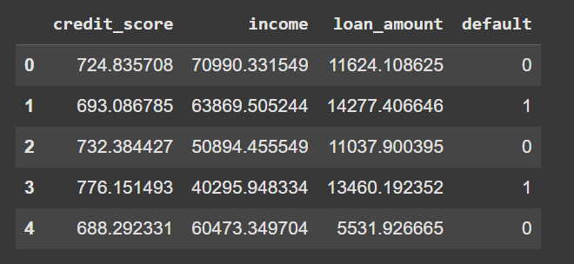
OUTPUT:

Slide 16
CREATE SYNTHETIC
REVENUE/EXPENSE DATA

Slide 17
# Create synthetic Revenue/Expense Data
np.random.seed(42)
dates = pd.date_range(start='2018-01-01', periods=60, freq='M')
revenue_data = pd.DataFrame({
'Date': dates,
'Revenue': 50000 + np.random.normal(0, 5000, size=60).cumsum(),
'Expenses': 30000 + np.random.normal(0, 3000, size=60).cumsum()
})
revenue_data['Profit'] = revenue_data['Revenue'] - revenue_data['Expenses']
revenue_data.head()

Slide 18
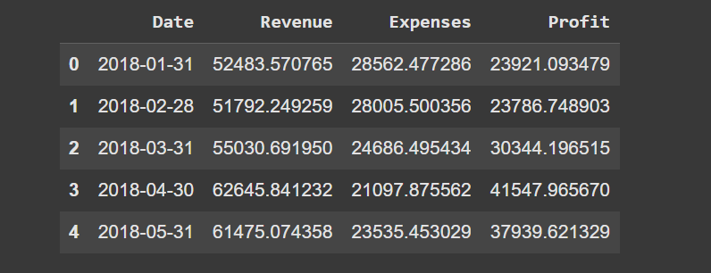
OUTPUT:

Slide 19
VISUALIZATION OF
REVENUE/EXPENSE DATA

Slide 20
from matplotlib import pyplot as plt
import seaborn as sns
def _plot_series(series, series_name, series_index=0):
palette = list(sns.palettes.mpl_palette('Dark2'))
xs = series['Date']
ys = series['Expenses']
plt.plot(xs, ys, label=series_name, color=palette[series_index % len(palette)])
fig, ax = plt.subplots(figsize=(10, 5.2), layout='constrained')
df_sorted = _df_21.sort_values('Date', ascending=True)
_plot_series(df_sorted, '')
sns.despine(fig=fig, ax=ax)
plt.xlabel('Date')
_ = plt.ylabel('Expenses')

Slide 21
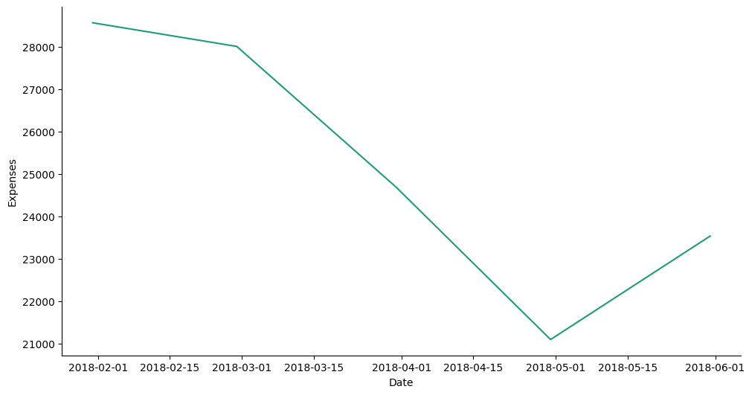
EXPENSES LINE GRAPH:

Slide 22

STOCK PRICE PREDICTION:

Slide 23
STOCK FORECASTING
Linear Regression:
RMSE, MAE, R²
ARIMA:
RMSE, MAE, R²
Include sample graph
(Actual vs Predicted)

Slide 24
Stock Price Prediction
(Linear Regression)

Slide 25
CODING:
# Features and Target
X = stock_data[['SMA_30', 'Volatility']]
y = stock_data['Close']
# Split the data
X_train, X_test, y_train, y_test = train_test_split(X, y, test_size=0.2, random_state=42)
# Linear Regression Model
lr_model = LinearRegression()
lr_model.fit(X_train, y_train)
# Predictions
y_pred_lr = lr_model.predict(X_test)
# Evaluation
print("Linear Regression:")
print("RMSE:", np.sqrt(mean_squared_error(y_test, y_pred_lr)))
print("MAE:", mean_absolute_error(y_test, y_pred_lr))
print("R²:", r2_score(y_test, y_pred_lr))
# Plot
plt.figure(figsize=(10,6))
plt.scatter(y_test, y_pred_lr)
plt.xlabel('Actual Closing Prices')
plt.ylabel('Predicted Closing Prices')
plt.title('Actual vs Predicted Closing Prices (Linear Regression)')
plt.grid(True)
plt.show()

Slide 26
OUTPUT:
Linear Regression: RMSE: 0.5371103494565133 MAE: 0.3539754161137575 R²: 0.9363571890060678

Slide 27
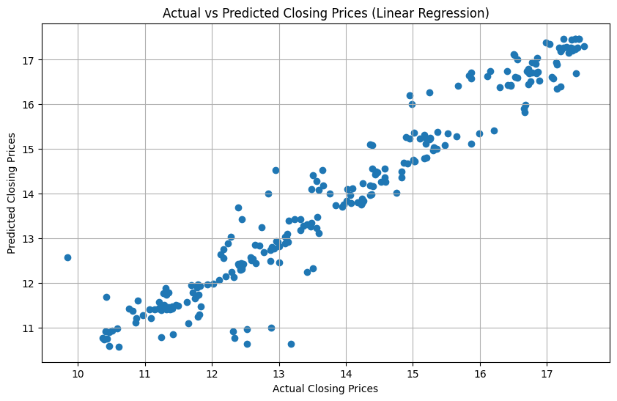

Slide 28
STOCK PRICE FORECASTING
(ARIMA Model)

Slide 29
CODING:
# ARIMA model needs only one series (we'll use 'Close')
train_size = int(len(stock_data) * 0.8)
train, test = stock_data['Close'][:train_size], stock_data['Close'][train_size:]
# Fit ARIMA
arima_model = ARIMA(train, order=(5,1,0))
arima_result = arima_model.fit()
# Forecast
arima_forecast = arima_result.forecast(steps=len(test))
# Evaluation
print("ARIMA Model:")
print("RMSE:", np.sqrt(mean_squared_error(test, arima_forecast)))
print("MAE:", mean_absolute_error(test, arima_forecast))
print("R²:", r2_score(test, arima_forecast))
# Plot
plt.figure(figsize=(12,6))
plt.plot(train.index, train, label='Training')
plt.plot(test.index, test, label='Actual')
plt.plot(test.index, arima_forecast, label='Forecast')
plt.legend()
plt.title('ARIMA Forecast vs Actual Stock Prices')
plt.grid(True)
plt.show()

Slide 30
OUTPUT:
ARIMA Model: RMSE: 2.8116882730572224 MAE: 2.5540617494793576 R²: -4.595486988837684

Slide 31
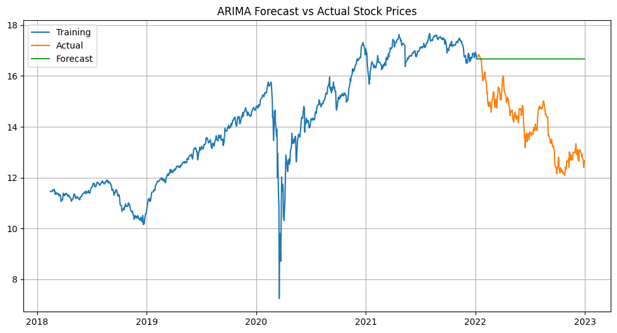
# Features and Target
X = stock_data[['SMA_30', 'Volatility']]
y = stock_data['Close']
# Split the data
X_train, X_test, y_train, y_test = train_test_split(X, y, test_size=0.2, random_state=42)
# Linear Regression Model
lr_model = LinearRegression()
lr_model.fit(X_train, y_train)
# Predictions
y_pred_lr = lr_model.predict(X_test)
# Evaluation
print("Linear Regression:")
print("RMSE:", np.sqrt(mean_squared_error(y_test, y_pred_lr)))
print("MAE:", mean_absolute_error(y_test, y_pred_lr))
print("R²:", r2_score(y_test, y_pred_lr))
# Plot
plt.figure(figsize=(10,6))
plt.scatter(y_test, y_pred_lr)
plt.xlabel('Actual Closing Prices')
plt.ylabel('Predicted Closing Prices')
plt.title('Actual vs Predicted Closing Prices (Linear Regression)')
plt.grid(True)
plt.show()

Slide 32
Credit Risk Modeling
(Logistic Regression + Decision Tree)

Slide 33
CREDIT RISK MODELING
Logistic Regression:
Accuracy, Precision, Recall, F1 Score
Decision Tree:
Accuracy, Precision, Recall, F1 Score
Mention use of lower probability threshold (0.3) for Logistic Regression

Slide 34
CODING:
Features and Target for Credit Risk
X_credit = credit_data[['credit_score', 'income', 'loan_amount']]
y_credit = credit_data['default'] # Train-Test Split
Xc_train, Xc_test, yc_train, yc_test = train_test_split(X_credit, y_credit, test_size=0.2, random_state=42)
# Logistic Regression
logreg_model = LogisticRegression()
logreg_model.fit(Xc_train, yc_train)
# Predictions using a lower probability threshold (e.g., 0.3)
yc_pred_logreg_proba = logreg_model.predict_proba(Xc_test)[:, 1] # Get probabilities for class 1
yc_pred_logreg = (yc_pred_logreg_proba >= 0.3).astype(int) # Apply threshold
# Decision Tree
tree_model = DecisionTreeClassifier(max_depth=5, random_state=42)
tree_model.fit(Xc_train, yc_train)
yc_pred_tree = tree_model.predict(Xc_test)
# Evaluation Function (with zero_division handling)
def evaluate_classification(y_true, y_pred, model_name):
print(f"--- {model_name} ---")
print("Accuracy:", accuracy_score(y_true, y_pred))
print("Precision:", precision_score(y_true, y_pred, zero_division=0)) # Handle zero division
print("Recall:", recall_score(y_true, y_pred, zero_division=0)) # Handle zero division
print("F1 Score:", f1_score(y_true, y_pred, zero_division=0)) # Handle zero division
print("\n")
# Evaluate both models
evaluate_classification(yc_test, yc_pred_logreg, "Logistic Regression")
evaluate_classification(yc_test, yc_pred_tree, "Decision Tree Classifier")

Slide 35
OUTPUT:
--- Logistic Regression ---
Accuracy: 0.865
Precision: 0.0
Recall: 0.0
F1 Score: 0.0
--- Decision Tree Classifier ---
Accuracy: 0.85
Precision: 0.0
Recall: 0.0
F1 Score: 0.0

Slide 36
Revenue/Expense Forecasting
(Simple Regression)

Slide 37
REVENUE FORECASTING
Linear Regression:
RMSE, MAE, R²
Graph showing Revenue
Prediction vs Actual Revenue

Slide 38
CODING:
# Revenue Forecasting
X_rev = np.arange(len(revenue_data)).reshape(-1,1)
y_rev = revenue_data['Revenue']
# Split
Xr_train, Xr_test, yr_train, yr_test = train_test_split(X_rev, y_rev, test_size=0.2, random_state=42)
# Regression Model
rev_model = LinearRegression()
rev_model.fit(Xr_train, yr_train)
# Predictions
yr_pred = rev_model.predict(Xr_test)
# Evaluation
print("Revenue Forecasting:")
print("RMSE:", np.sqrt(mean_squared_error(yr_test, yr_pred)))
print("MAE:", mean_absolute_error(yr_test, yr_pred))
print("R²:", r2_score(yr_test, yr_pred))
# Plot
plt.figure(figsize=(10,6))
plt.scatter(Xr_test, yr_test, color='blue', label='Actual Revenue')
plt.plot(Xr_test, yr_pred, color='red', label='Predicted Revenue')
plt.legend()
plt.title('Revenue Forecasting')
plt.xlabel('Time Periods')
plt.ylabel('Revenue')
plt.grid(True)
plt.show()

Slide 39
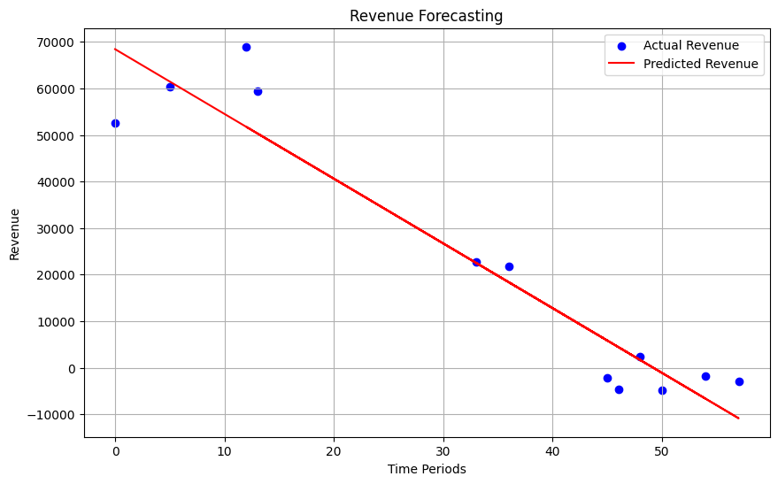
OUTPUT:
Revenue Forecasting: RMSE: 8623.359103500814 MAE: 6765.603038483262
R²:
0.9068358390167899

Slide 40
Geometric Brownian Motion
(GBM) Simulation

Slide 41
CODING:
# Correct GBM Simulation
def simulate_gbm(S0, mu, sigma, T, dt=1/252):
N = int(T/dt)
t = np.linspace(0, T, N)
W = np.random.standard_normal(size=N)
W = np.cumsum(W) * np.sqrt(dt) # Brownian motion
X = (mu - 0.5 * sigma**2) * t + sigma * W
S = S0 * np.exp(X)
return t, S
# FIX S0 to float (not Series!) - Use .iloc[0] to extract the value
S0 = stock_data['Close'].iloc[-1] # Last close price as float
# Convert S0 to a float using .iloc[0] to avoid the FutureWarning
S0 = float(S0.iloc[0]) if hasattr(S0, 'iloc') else float(S0)
mu = stock_data['Log_Returns'].mean() * 252
sigma = stock_data['Log_Returns'].std() * np.sqrt(252)
T = 1 # 1 year
# Simulate GBM
t, S = simulate_gbm(S0, mu, sigma, T)
# Plot
plt.figure(figsize=(10,6))
plt.plot(t, S)
plt.title('Simulated Asset Prices using Geometric Brownian Motion')
plt.xlabel('Time (Years)')
plt.ylabel('Price')
plt.grid(True)
plt.show()

Slide 42
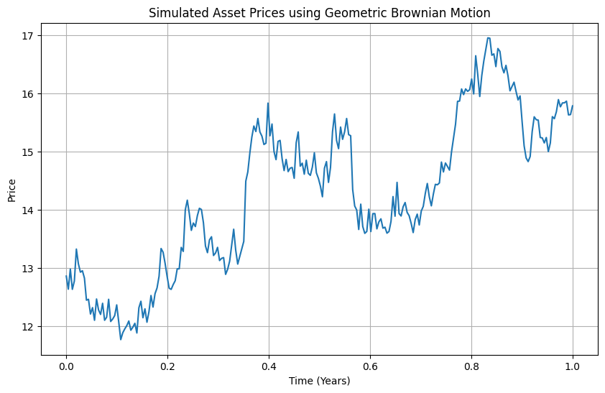

Slide 43
Option Pricing with
Binomial Tree

Slide 44
CODING
# Correct Binomial Tree Call Option Pricing
def binomial_tree_call_price(S, K, T, r, sigma, N):
dt = T / N
u = np.exp(sigma * np.sqrt(dt))
d = 1 / u
p = (np.exp(r * dt) - d) / (u - d)
# Asset prices at maturity
ST = np.array([S * (u**j) * (d**(N - j)) for j in range(N + 1)])
# Option values at maturity
option = np.maximum(ST - K, 0)
# Step backwards
for i in range(N-1, -1, -1):
option = np.exp(-r*dt) * (p*option[1:i+2] + (1-p)*option[0:i+1])
# Debugging print statements
print("Final Option Values:", option)
print("Discount Factor:", np.exp(-r * dt))
print("Up Factor (u):", u)
print("Down Factor (d):", d)
print("Probability (p):", p)
return option[0] # ONLY option[0]
# Parameters
K = 15 # Strike price
r = 0.03 # Risk-free rate
N = 50 # Number of steps
T = 1 # Time to maturity (1 year)
# Correct Extraction of S0
S0_value = stock_data['Close'].iloc[-1]
if hasattr(S0_value, 'values'):
S0_value = S0_value.values[0]
# Calculate
binomial_price = binomial_tree_call_price(S0_value, K, T, r, sigma, N)
print("S0:", S0_value)
print(f"Binomial Tree Call Option Price: {binomial_price:.2f}")

Slide 45
OUTPUT:
Final Option Values: [0.86932835]
Discount Factor: 0.9994001799640054
Up Factor (u): 1.0441771121940122
Down Factor (d): 0.9576919359004261
Probability (p): 0.4961340888052443
S0: 12.667119026184082
Binomial Tree Call Option Price: 0.87

Slide 46
Option Pricing with
Black-Scholes Formula

Slide 47
BLACK-SCHOLES:
OUTPUT:
Black-Scholes Call Option Price: 0.88
# Black-Scholes Call Option Pricing
def black_scholes_call(S, K, T, r, sigma):
d1 = (np.log(S/K) + (r + 0.5*sigma**2)*T) / (sigma*np.sqrt(T))
d2 = d1 - sigma*np.sqrt(T)
call = S * norm.cdf(d1) - K * np.exp(-r*T) * norm.cdf(d2)
return call
# Calculate
# Use S0_value directly as it's already a float
bs_price = black_scholes_call(S0_value, K, T, r, sigma)
print(f"Black-Scholes Call Option Price: {bs_price:.2f}")

Slide 48
FINANCIAL INTERPRETATIONS
Stock Forecasting: Useful for investment decisions
Credit Risk Modeling: Helps in predicting potential defaults
Revenue Forecasting: Assists in budgeting and strategic planning

Slide 49
Exploratory Data Analysis (EDA)
CORRELATION MATRIX

Slide 50
CODING:
# EDA: Correlation Matrix
plt.figure(figsize=(8,6))
sns.heatmap(stock_data[['Close', 'SMA_30', 'Volatility', 'Log_Returns']].corr(), annot=True, cmap='coolwarm')
plt.title('Correlation Matrix of Stock Features')
plt.show()

Slide 51
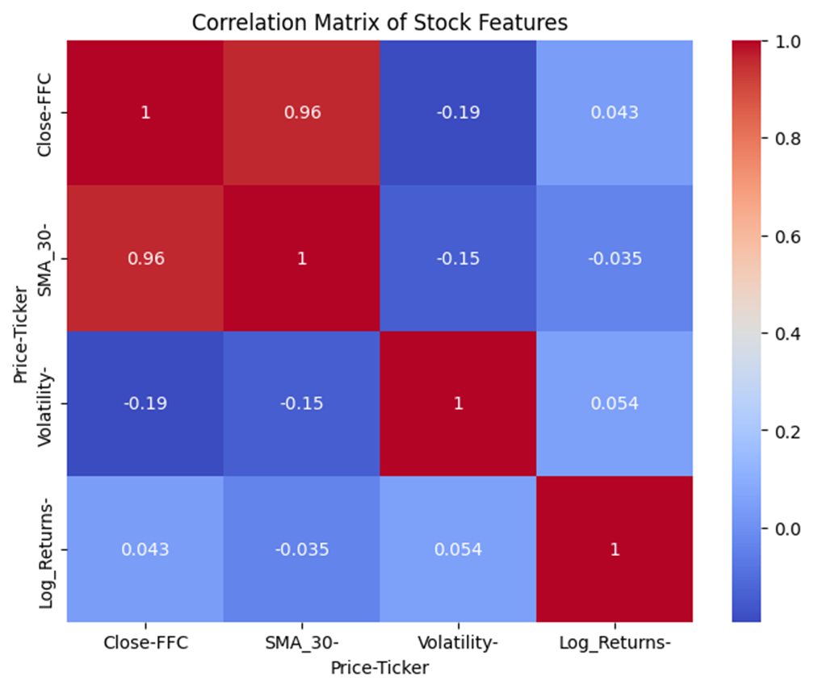
INTERPRETATION:
Strong positive correlation between Close Price and SMA_30 shows that moving averages are reliable for trend analysis.
Negative correlation between Volatility and Close Price suggests that when price increases, uncertainty (volatility) reduces.
Log Returns' relationships highlight asset return dynamics needed for derivative pricing.
From a derivatives finance view, understanding correlations supports better hedging strategies using options and structured products..

Slide 52
Exploratory Data Analysis (EDA)
TREND OVER TIME

Slide 53
CODING:
# Trend over Time
plt.figure(figsize=(12,6))
plt.plot(stock_data.index, stock_data['Close'], label='Close Price')
plt.plot(stock_data.index, stock_data['SMA_30'], label='30-Day SMA')
plt.legend()
plt.title('Stock Price vs 30-Day SMA')
plt.xlabel('Date')
plt.ylabel('Price')
plt.grid(True)
plt.show()

Slide 54
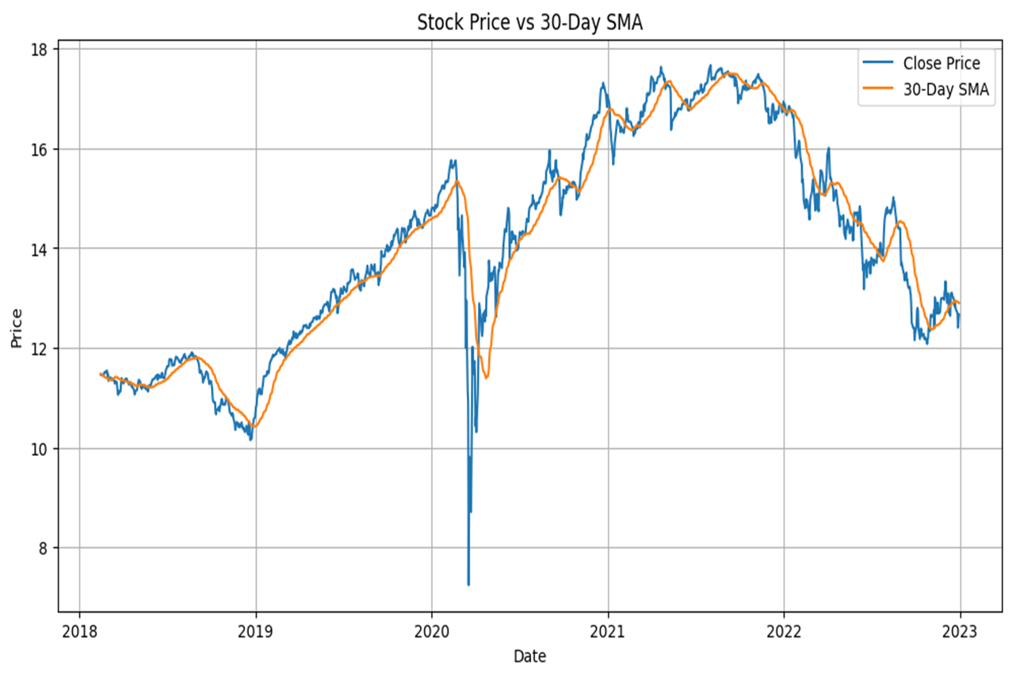
OUTPUT:
INTERPRETATION:
When the stock price crosses above the SMA, it is often seen as a bullish signal — suggesting that buying interest is increasing.
When the stock price falls below the SMA, it is seen as bearish, signaling potential declines.
From a corporate finance view, stock price trends reflect market valuation and investor confidence about the company's future earnings and stability.

Slide 55
Exploratory Data Analysis (EDA)
BAR CHART

Slide 56
CODING:
# Revenue and Expenses Bar Plot
plt.figure(figsize=(14,6))
plt.bar(revenue_data['Date'], revenue_data['Revenue'], label='Revenue', color='green')
plt.bar(revenue_data['Date'], revenue_data['Expenses'], label='Expenses', color='red', alpha=0.6)
plt.title('Revenue vs Expenses Over Time')
plt.xlabel('Date')
plt.ylabel('Amount ($)')
plt.legend()
plt.xticks(rotation=45)
plt.grid(True)
plt.show()

Slide 57
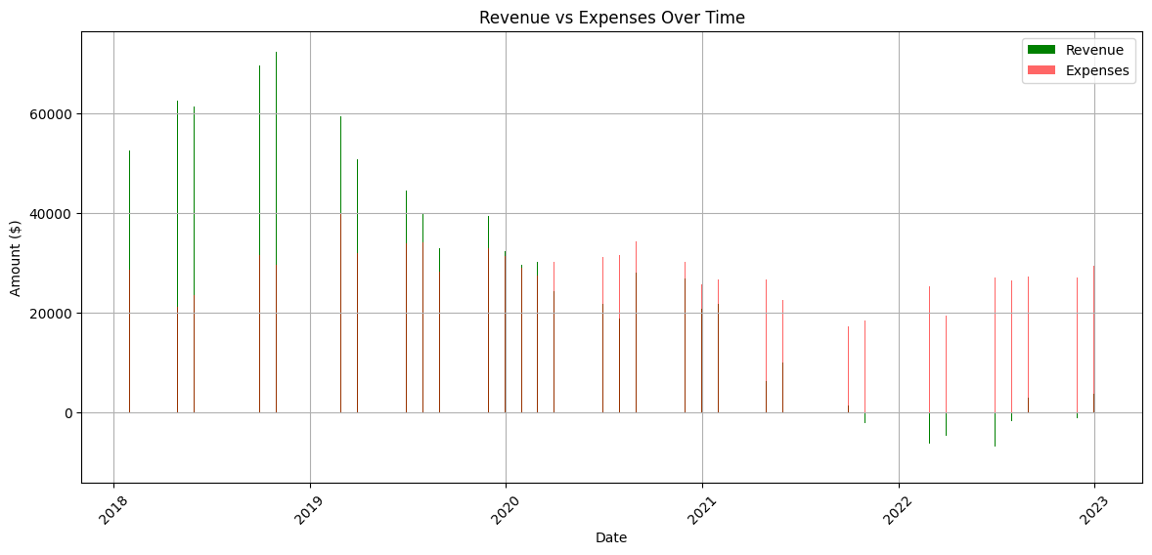
INTERPRETATION:
Revenue and Expense analysis shows the operational performance of a company.
Expenses show strong financial management and good cash flow, leading
to better credit ratings and investment
attractiveness.
If Expenses rise faster than Revenue, it signals cost inefficiency and future profit margin compression, which could lower stock valuation.

Slide 58
Exploratory Data Analysis (EDA)
SCATTER PLOT

Slide 59
CODING:
# Scatter Plot: Credit Score vs Loan Amount
plt.figure(figsize=(8,6))
plt.scatter(credit_data['credit_score'], credit_data['loan_amount'], alpha=0.5)
plt.title('Credit Score vs Loan Amount')
plt.xlabel('Credit Score')
plt.ylabel('Loan Amount')
plt.grid(True)
plt.show()

Slide 60
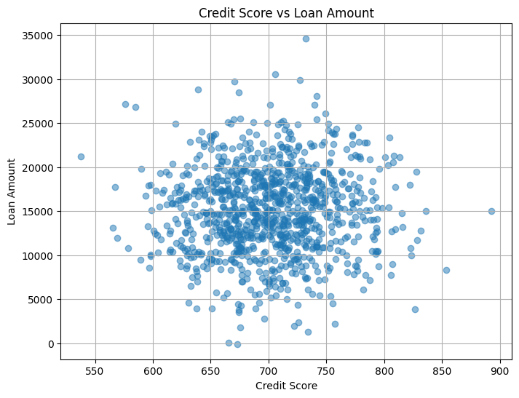
INTERPRETATION:
If many high loan amounts are given to low credit score borrowers, it reflects a risky lending portfolio, requiring higher provisions for bad debts.
From a corporate finance view, riskier loans can increase credit loss expenses, reducing net income and affecting equity valuations.

Slide 61
THANK
YOU

